Slide 1

Vel Tech Rangarajan Dr. Sagunthala R&D Institute of Science and Technology
School of Computing
Department of Computer Science and Engineering
10211CS224 / FULL STACK APPLICATION DEVELOPMENT (JAVA)
PROJECT REVIEW : MILESTONE PROJECT – 1
Date: DD-MM-YYYY
END-END EVENT LIFECYCLE & TICKETING
SDG: SDG No – SDG Title(Example: SDG 4 – Quality Education)
Presented By:
CH SRICHARAN – VTU25719 – 23UECS0106
Courses Handling Faculty:
Dr. X.Arogya Presskila/Assistant Professor

Slide 2
INTRODUCTION
Traditional event booking often relies on fragmented systems, leading to overbooking, manual errors, and frustrating user experiences.
Event organizers struggle to track ticket sales and manage seats in real-time, while attendees face slow and restrictive booking processes.
This project provides a centralized, automated platform that eliminates manual ticketing errors and ensures secure, real-time seat synchronization.
In a digital-first era, users expect 24/7 self-service access to event discovery and instantaneous booking for everything from local meetups to major conferences.
EventX equips organizers with vital data-driven insights through analytics, enabling them to comprehend audience trends and optimally manage venue capacity.
The platform is a modern full-stack web application built using Node.js, Express, HTML, CSS, JavaScript, and a MySQL relational database.
Attendees can effortlessly browse events, instantly view live seat availability, securely book tickets, and track their personal booking history.
Administrators utilize a powerful dashboard to create and edit events, cleanly manage all user bookings, and view dynamic visual charts for revenue and ticket utilization.
1
2
3
4
5
6
7
8
9

Slide 3
PROBLEM STATEMENT
1
In the event management industry, organizers and attendees frequently suffer from fragmented and inefficient ticketing processes that rely on manual tracking or disconnected platforms. This lack of a centralized system leads to critical issues such as seat overbooking, delayed revenue reconciliation, and a frustrating, restrictive booking experience for users—especially during high-demand events. Furthermore, administrators lack access to real-time data analytics, making it difficult to understand audience behavior, optimize venue capacity, and maximize ticketing efficiency. EventX addresses these challenges by providing a secure, automated, full-stack ticketing platform that guarantees real-time seat synchronization and equips organizers with comprehensive, data-driven management tools.
2
3
4
5
6
7
8
9

Slide 4
OBJECTIVE(S)
To design and develop a centralized, full-stack event ticketing web application that enables users to browse events, view real-time seat availability, and securely book tickets.
To implement a comprehensive administrative dashboard that allows organizers to manage event details, track all bookings, and visualize real-time revenue and seat utilization analytics.
1
2
3
4
5
6
7
8
9

Slide 5
PROPOSED SYSTEM
Comprehensive Ticketing Platform: The proposed solution is a full-stack web application that digitizes the entire event lifecycle, offering a robust backend API and responsive frontend interfaces.
Unified Event Management: It solves fragmentation by combining event creation, ticket inventory tracking, and payment calculation into one synchronized database system.
Real-Time Seat Synchronization: The system actively updates available seating during the checkout process, completely eliminating the risk of overbooking common in manual systems.
Automated Event Statuses: The platform automatically manages event statuses (e.g., upcoming, ongoing, completed), reducing the administrative burden of manually tracking timelines.
Centralized Admin Dashboard: It provides organizers with a powerful dashboard consolidating all booking details and user data in an easily accessible tabular format.
Data-Driven Visual Analytics: It offers distinct advantages with integrated, charting analytics that visualize ticket utilization and revenue distribution, allowing organizers to make immediate, informed decisions.
Enhanced User Experience: Attendees benefit from an intuitive UI with fast searching, filtering by status, and immediate feedback on transactions, far superior to traditional physical or slow ticketing queues.
Secure Authentication: Built-in JWT and Bcrypt integrations ensure that booking and administrative access remain insulated, providing higher security over legacy systems
1
2
3
4
5
6
7
8
9

Slide 6
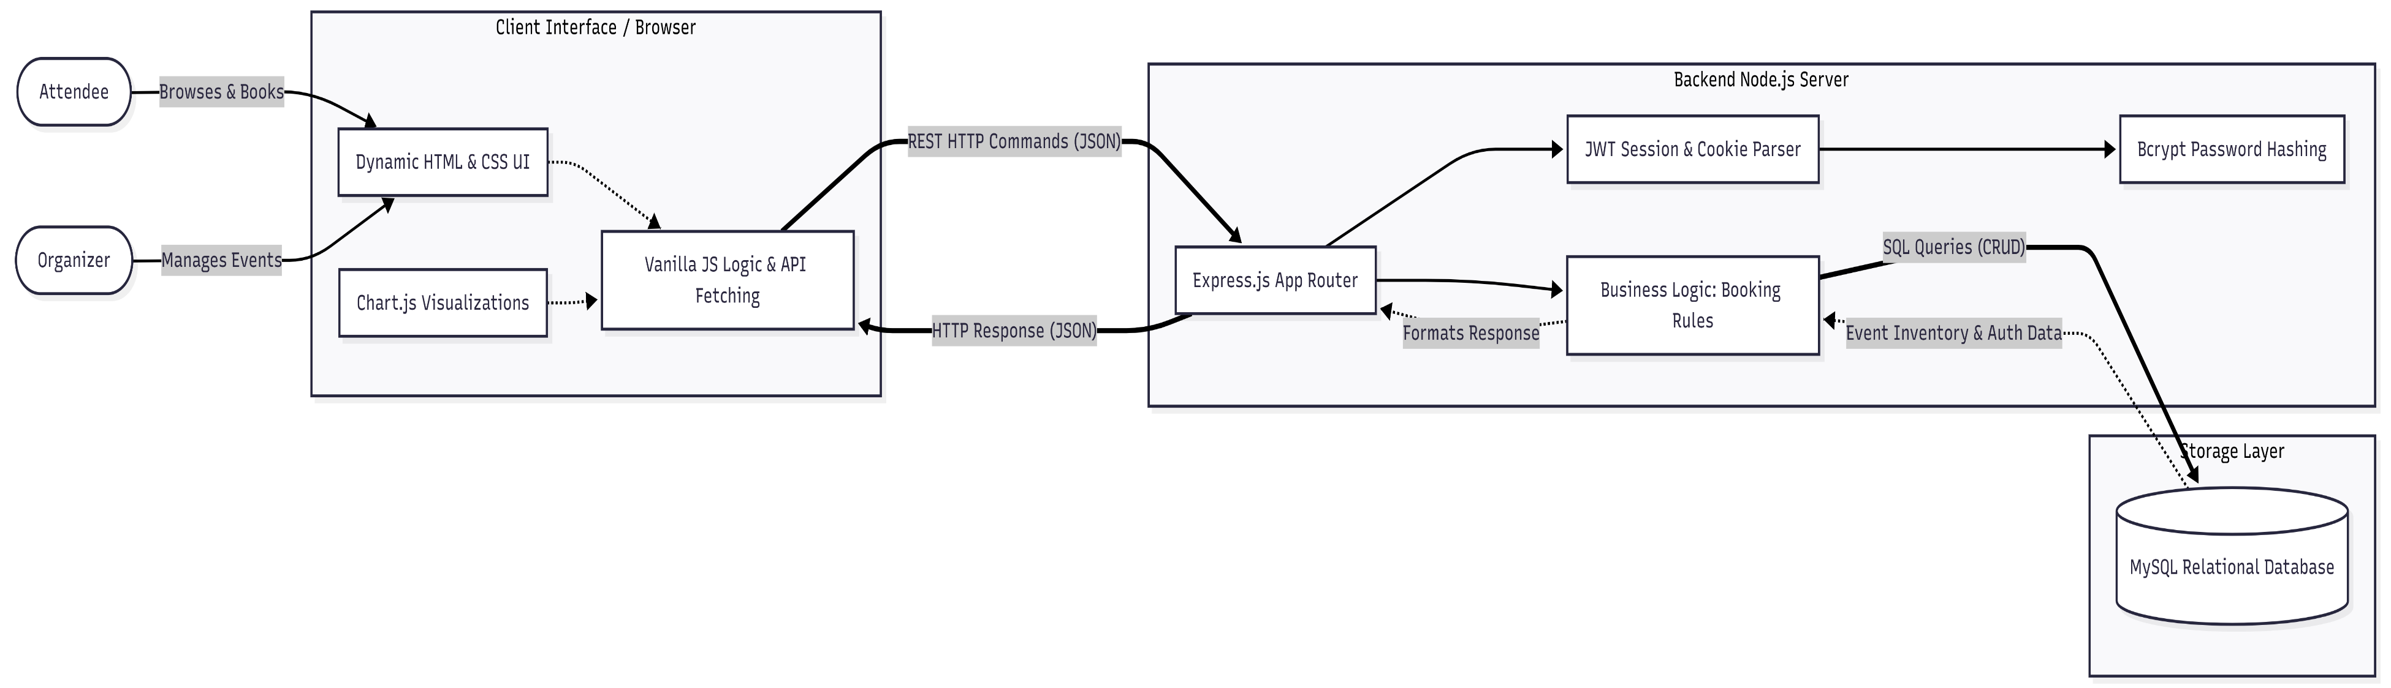
PROPOSED SYSTEM ARCHITECTURE
1
2
3
4
5
6
7
8
9

Slide 7
PROPOSED SYSTEM ARCHITECTURE
1
1. Input The Input phase comprises the frontend client interface built with HTML, CSS, and JavaScript. Users and administrators interact with the system through web browsers. They provide inputs such as login credentials, search queries, event creation details (date, venue, price), and requests to book specific quantities of tickets.
2. Processing The Processing phase is handled by the backend Node.js server using the Express.js framework. When the server receives an HTTP request from the frontend, it first passes through Authentication Middleware. This middleware verifies JWT tokens for session security and uses Bcrypt to validate passwords. Next, the Business Logic processes the request—for instance, verifying if an event is still “upcoming” and checking if the requested number of seats is available before allowing a booking to proceed.
3. Database The database uses 3 different tables ie events, users,bookings.
4. Output The frontend JavaScript receives this JSON and dynamically updates the UI. For users, the output includes live event listings, dynamic seat progress bars, and booking confirmation modals. For administrators, the output includes visually rendered charting data (via Chart.js) showing revenue trends and ticket utilization across all events.
2
3
4
5
6
7
8
9

Slide 8
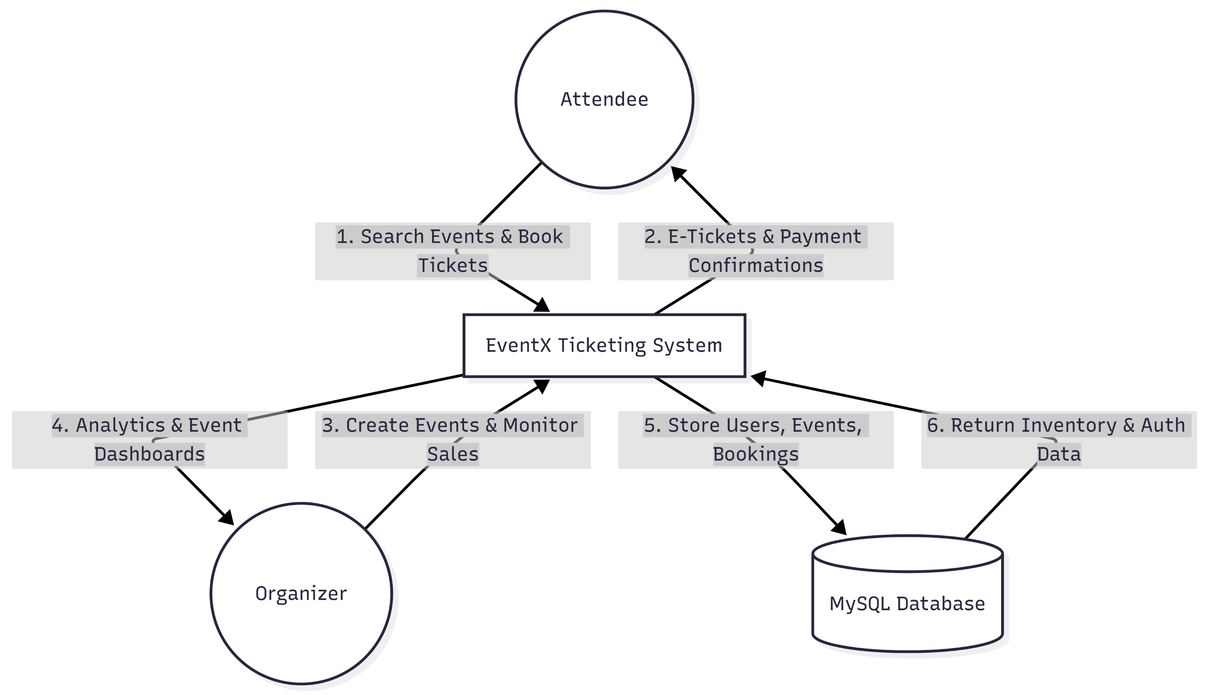
WORKFLOW
1
2
3
4
5
6
7
8
9

Slide 9
TECHNOLOGIES USED
1
Frontend: HTML5, CSS3, JavaScript
Backend: Node.js, Express.js
Database: MySQL
Tools: Chart.js, JWT, Bcrypt.js, Nodemon
Hardware Requirements: Intel Core i3 / AMD Ryzen 3+, 4GB RAM, 250MB Storage
Software Requirements: Windows/macOS/Linux, Node.js v16+, MySQL Server 8.0+, Modern Web Browser (Chrome/Edge/Firefox)
2
3
4
5
6
7
8
9

Slide 10
MODULE DESCRIPTION
Module 1: User & Authentication Management Handles user registration, highly secure JWT-based login, password encryption, and distinguishes access levels between regular attendees and system administrators.
Module 2: Core Event & Booking Interface Allows users to seamlessly browse upcoming events, filter by status or search terms, and execute secure ticket bookings with real-time seat tracking to prevent double-booking.
Module 3: Database & Transaction Management Manages the structured MySQL relational database, executing core business logic, calculating transaction amounts, and ensuring strict data integrity across user profiles, events, and records.
Module 4: Admin Reporting & Analytics Dashboard Equips administrators with tools to create, edit, or delete events, monitor full booking histories, and view rich, auto-generated charts detailing revenue and venue utilization.
1
2
3
4
5
6
7
8
9

Slide 11
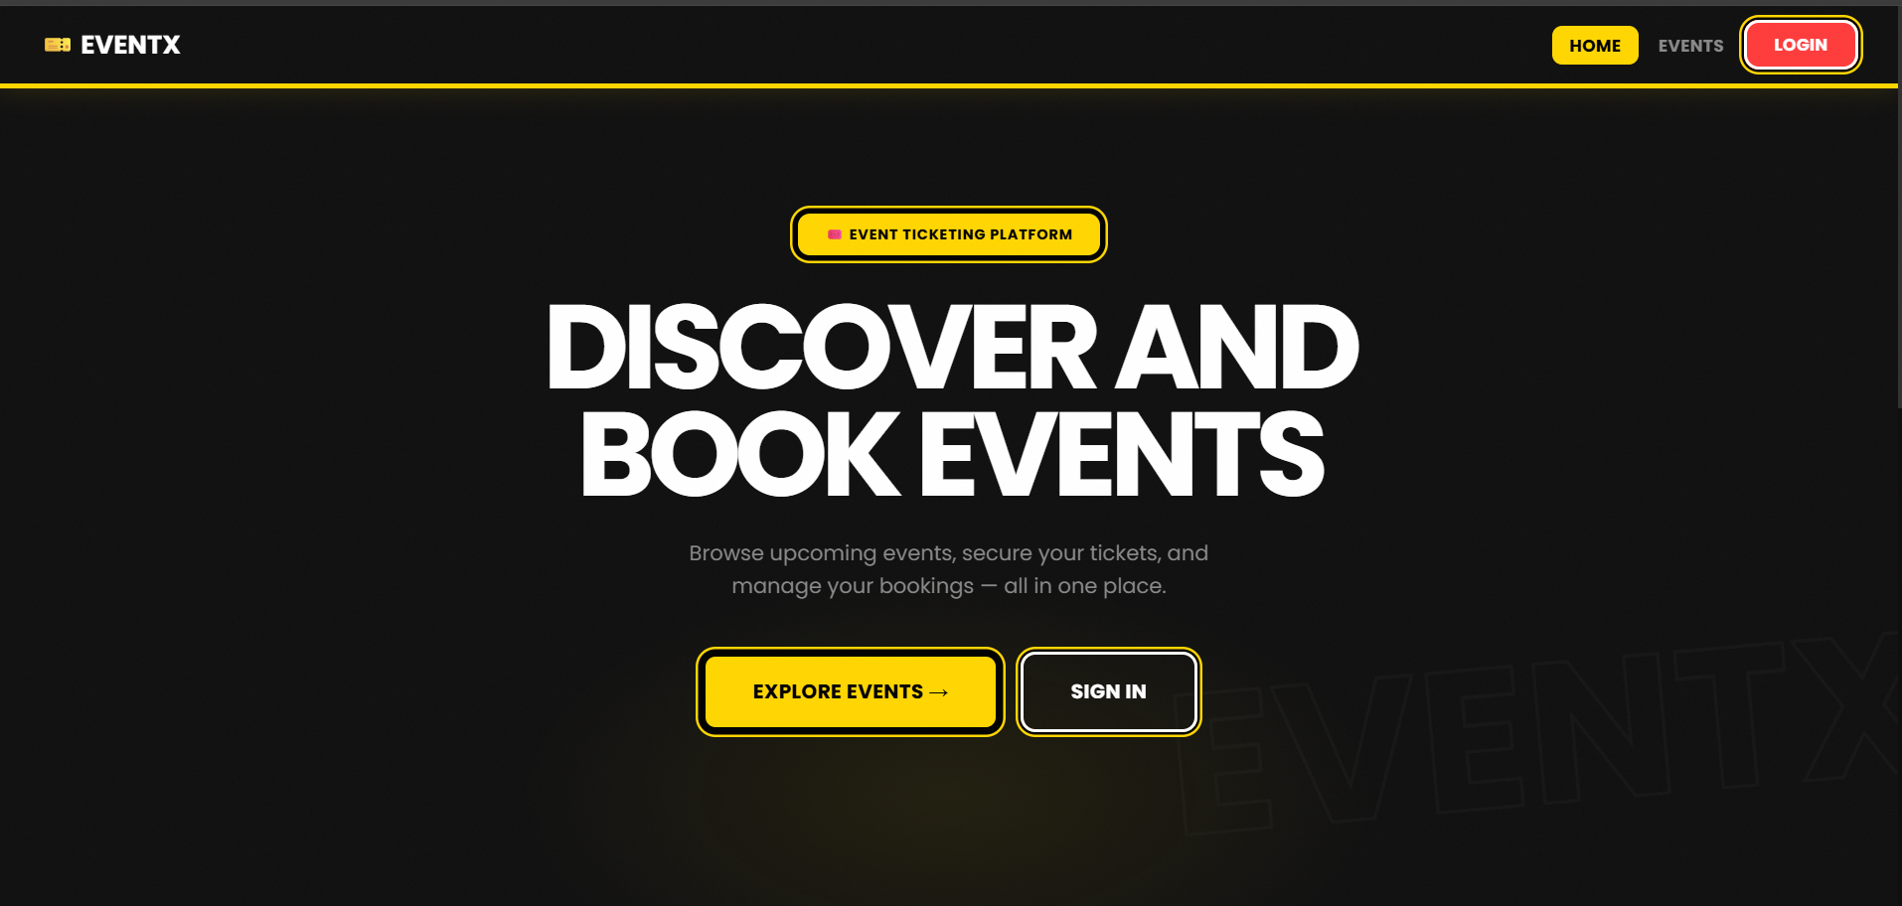
IMPLEMENTATION SCREENSHOTS
1
2
3
4
5
6
7
8
9
This Is the home page which is used to interact and navigate users to various sections of the website
It’s main purpose is to guide the users.

Slide 12
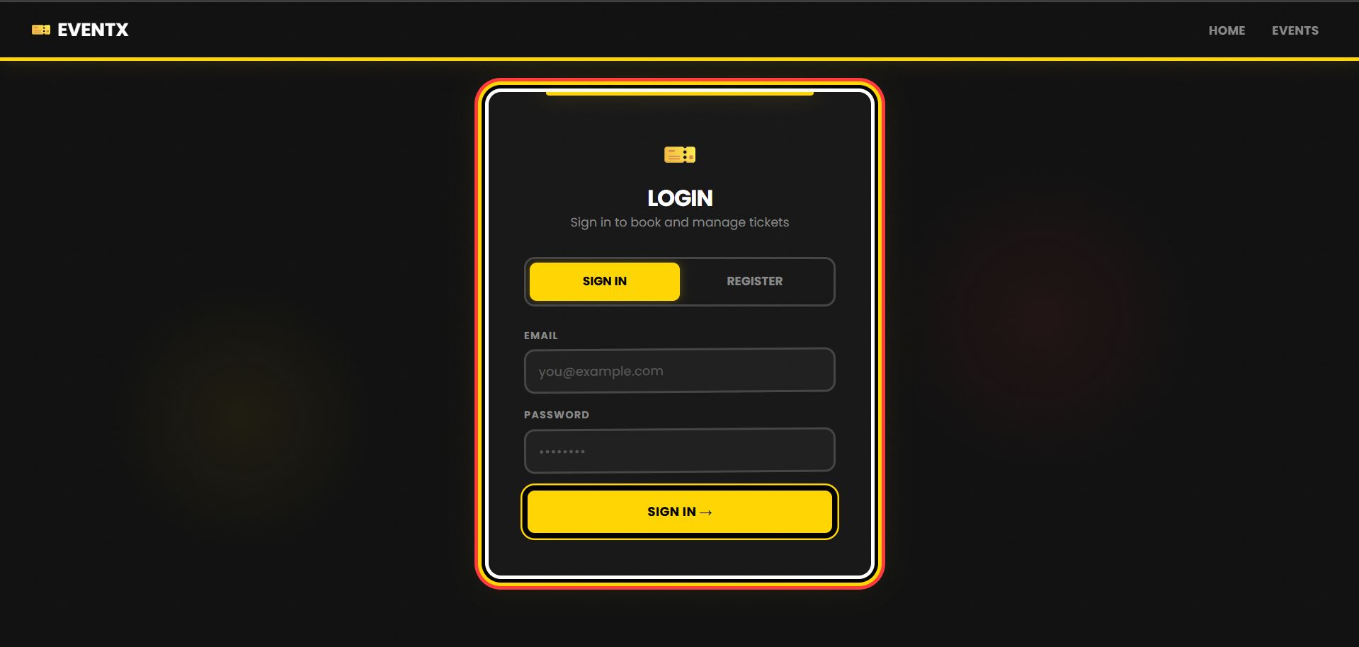
IMPLEMENTATION SCREENSHOTS
1
2
3
4
5
6
7
8(A)
9
This is the login page where the user has to enter the credentials in order to access the webpage for booking the events or exploring the events
Fields required (username, password)

Slide 13
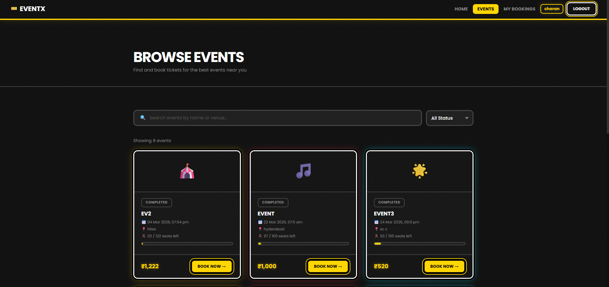
IMPLEMENTATION SCREENSHOTS
1
2
3
4
5
6
7
8(B)
9
This page is used for browsing events and can also be used to book tickets for the events.
Events can be added via admin panel

Slide 14
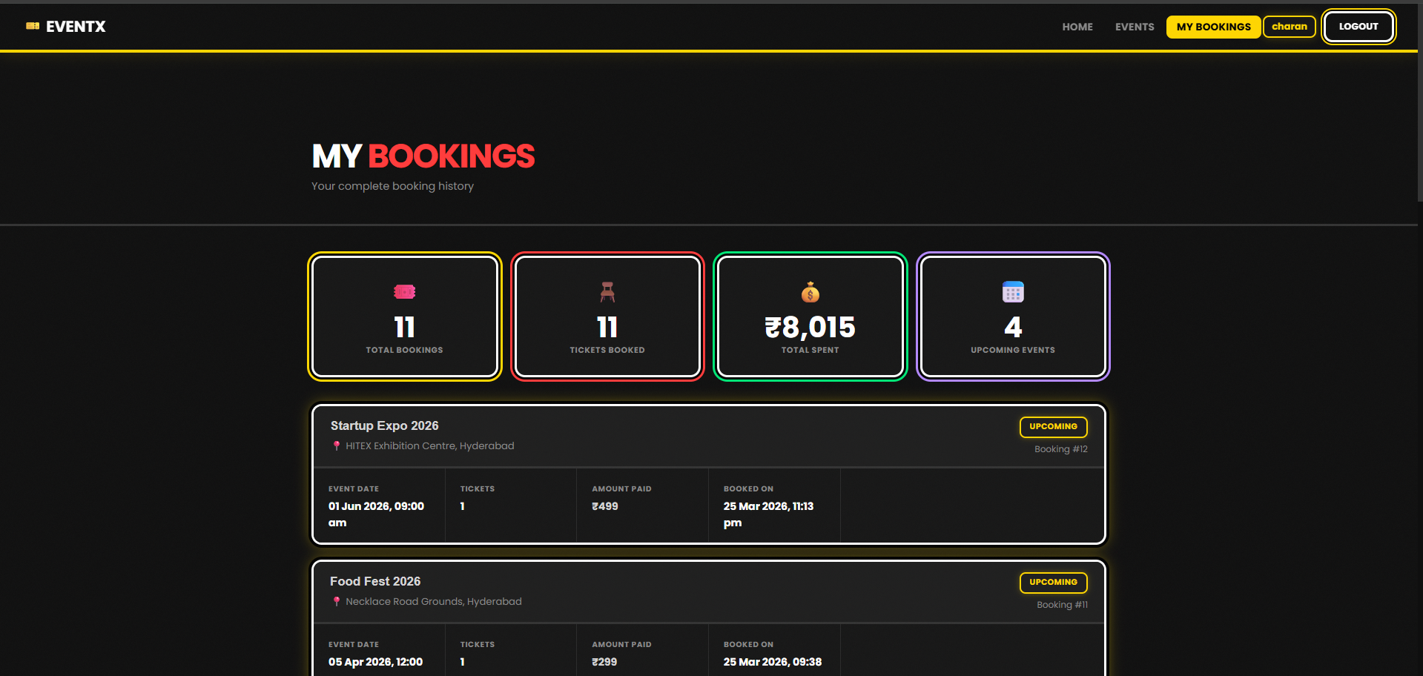
IMPLEMENTATION SCREENSHOTS
1
2
3
4
5
6
7
8(C)
9
Event booking history is shown via user dashboard.
User can see/access his/her bookings via my bookings tab

Slide 15
ADVANTAGES & LIMITATIONS
Advantages
Efficiency: Automates the complete event lifecycle, greatly reducing manual administrative work.
Accurate Real-Time Seating: Database transaction logic automatically updates live seat availability, strictly preventing double-booking during checkouts.
Data Analytics: Features an integrated dashboard with interactive charts, allowing organizers to easily visualize revenue and ticket utilization.
High Security: Uses secure password encryption (Bcrypt) and session handling (JWT) to deeply separate administrative powers from standard user behavior.
User Convenience: Attendees can enjoy a self-serve platform 24/7 to browse, instantly book tickets, and manage their personal transaction history.
Limitations
Demand Scalability: It currently relies on a single database layout, which could result in a system bottleneck when thousands of users simultaneously try to book seats for a very high-demand event.
Payment Processing: While internal accounting is handled perfectly, it requires integration with an external payment gateway (like Stripe) in the future to actually process live credit card transactions.
No Push Notifications: The platform does not currently send proactive confirmation emails or SMS reminders for upcoming events; users must check their status within the dashboard.
1
2
3
4
5
6
7
8
9

Slide 16
Thank you

